Slide 1
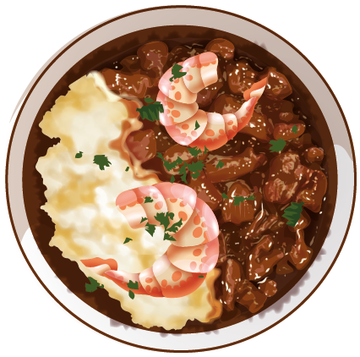


Dining Management System of Khulna University
Sumaiah Binta Musa || Istyaque Ahammed || Samundra Dhakal 190205 || 200240 || 200245

Slide 2

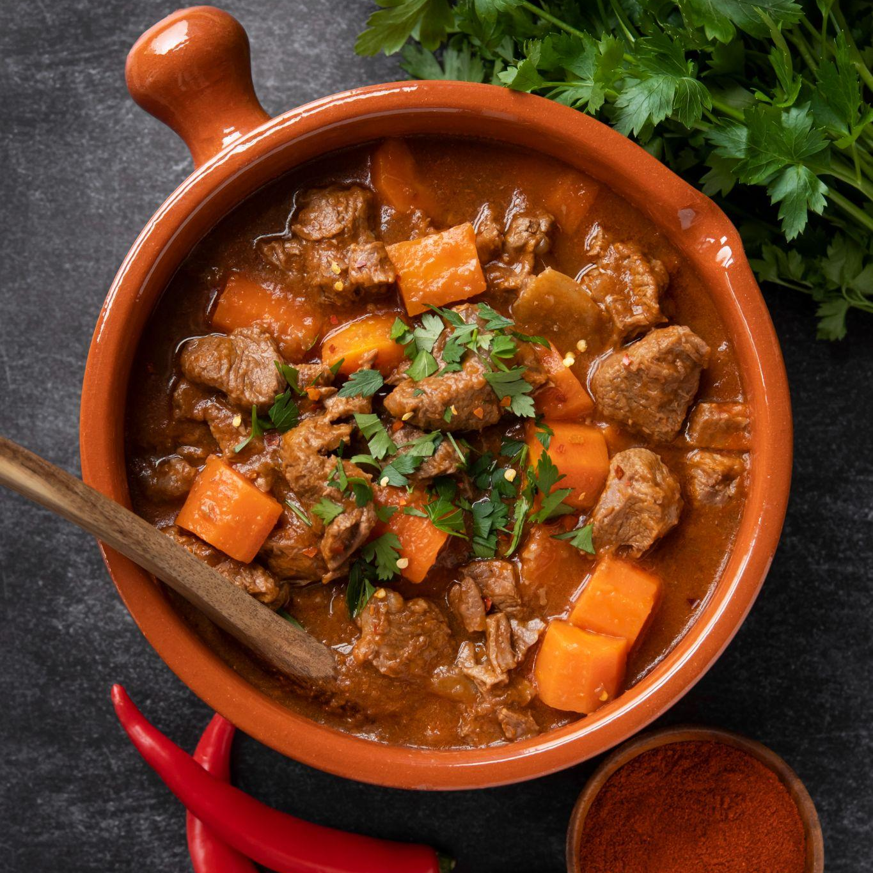
Introduction
Database system for converting dining hall meal receipt and payment process from manual to online. Students can pre-order lunch and dinner with pre-payment facility using the system. Easy order management facility using database for dining managers and users.

Slide 3
Hall Of Khulna University
01
Jatir Janak Bangabandhu Sheikh Mujibur Rahman Hall
02
Khan Jahan Ali Hall
Khan Bahadur Ahasanullah Hall
03
04
Aparajita Hall
05
Bongomata Begum Fazilattunesa Mujib Hall

Slide 4
What is motivation for this project?

Slide 5
Interesting queries:
In our system there can be two types of query. One is from manager side and another is from user side.
Manager queries:
Total amount of meals per day.
Total amount of money per day.
List of students of taking every day meal.
Which students take highest meal per month?
In which day of week highest number of students take meal.
User queries:
How much money he/she spend for meal per month.
How many days he/she takes meal in a particular month.

Slide 6
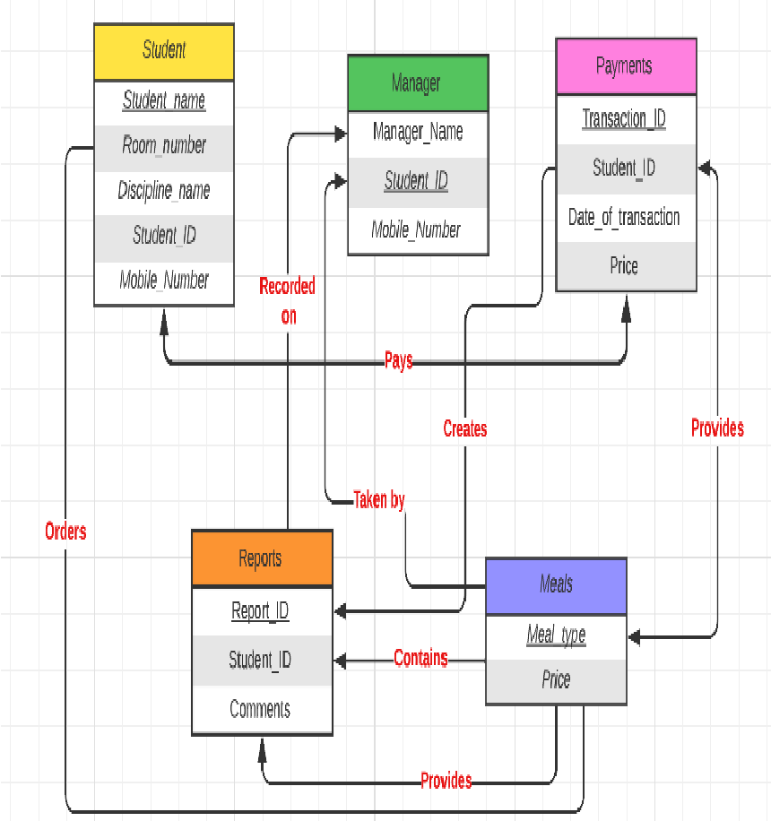
E-R Diagram

Slide 7
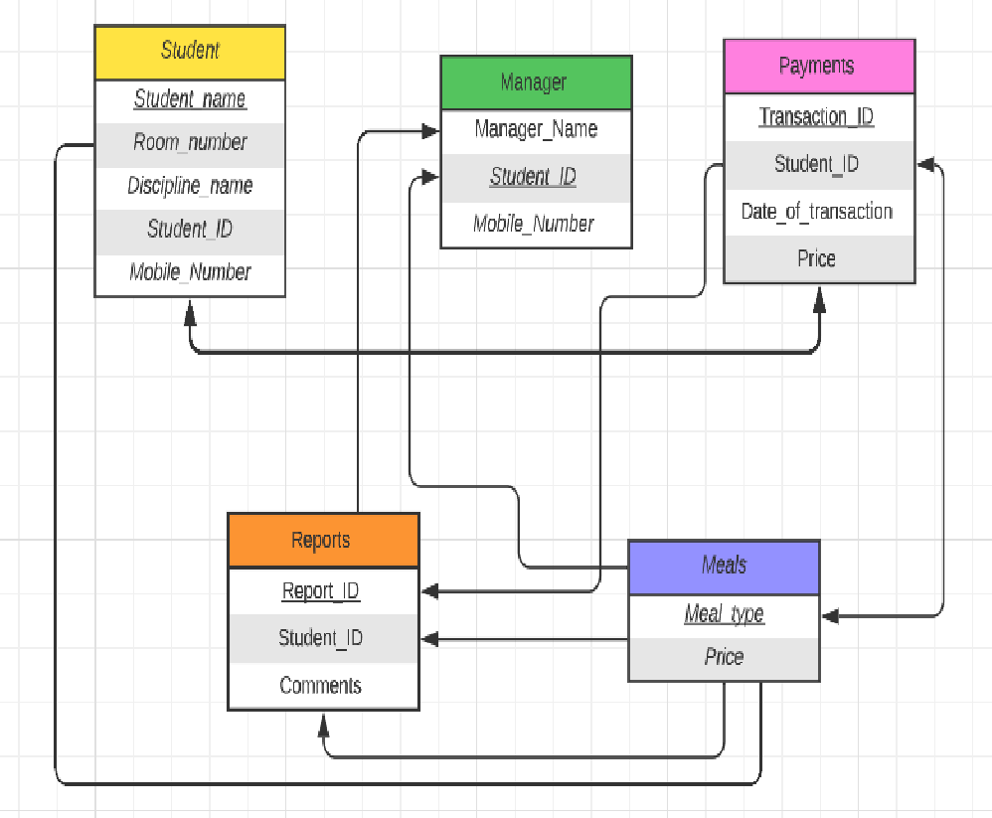
Schema Diagram

Slide 8
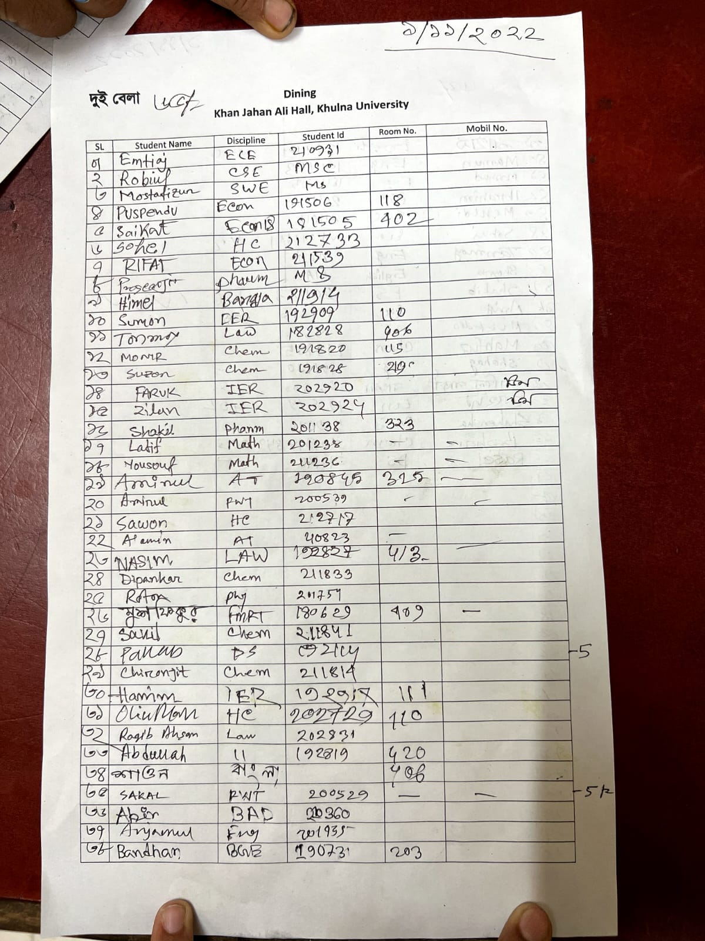
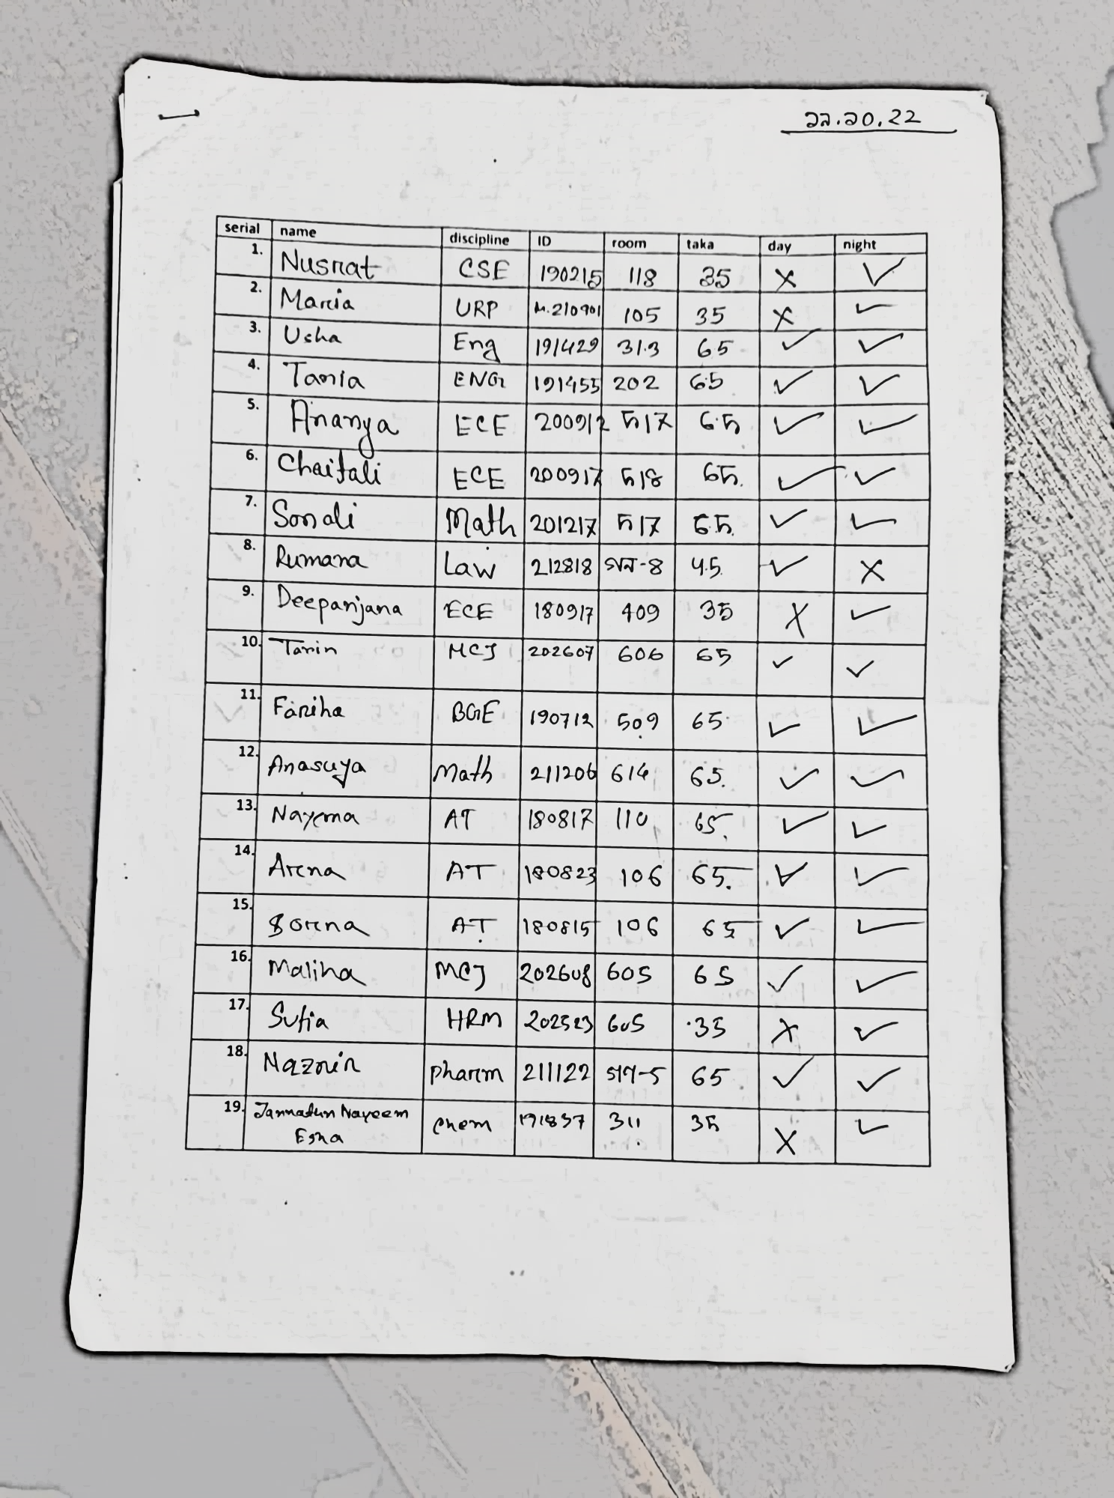
Related Documents

Slide 9
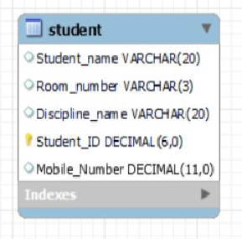
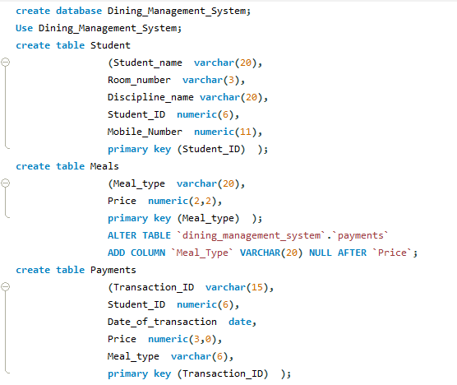
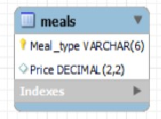

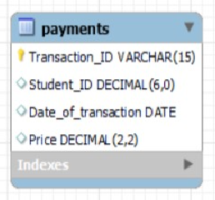
SQL Command

Slide 10
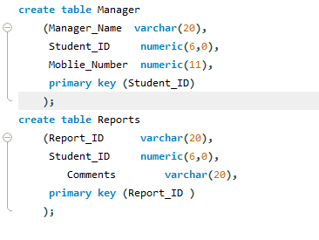
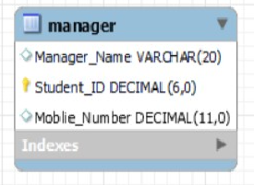
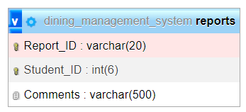
SQL Command

Slide 11
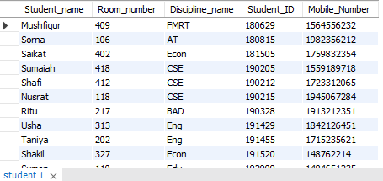
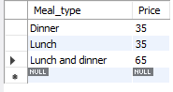
Data Entry
Student Table
Meals Table

Slide 12
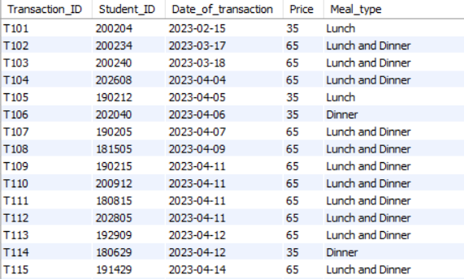
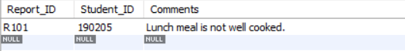
Data Entry
Payments Table
Reports Table

Slide 13
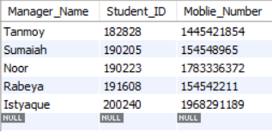
Data Entry
Manager Table

Slide 14
Normalization
All the tables: Student Table, Meals Table, Payments Table, Reports Table, Manager Table contains unique data and all of them satisfies the 1st Normal Form, 2nd Normal Form and 3rd Normal Form.

Slide 15
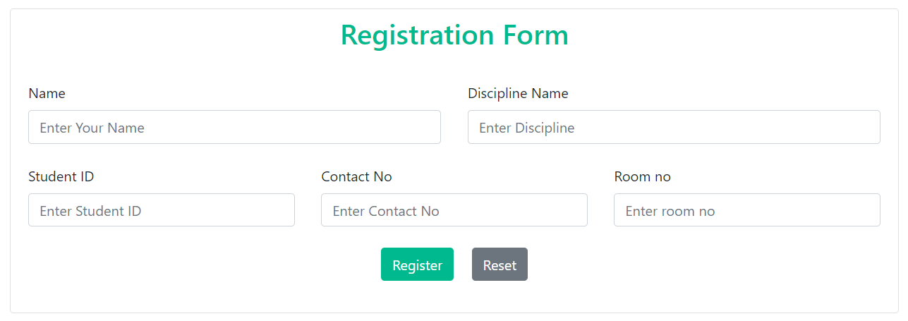
Registration Form

Slide 16
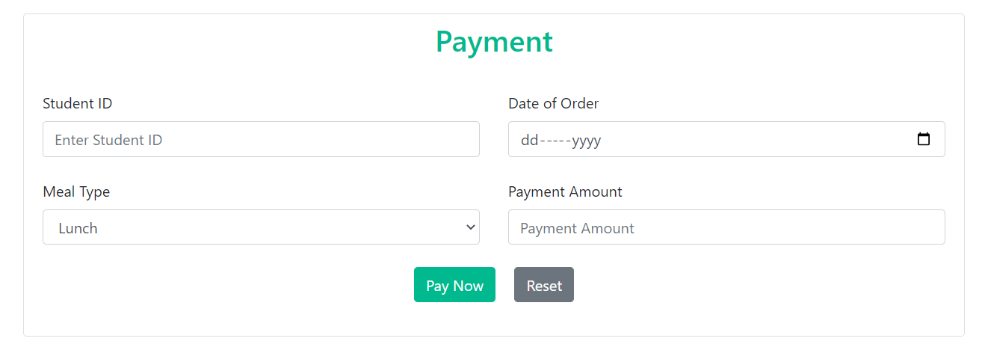
Payment Form

Slide 17
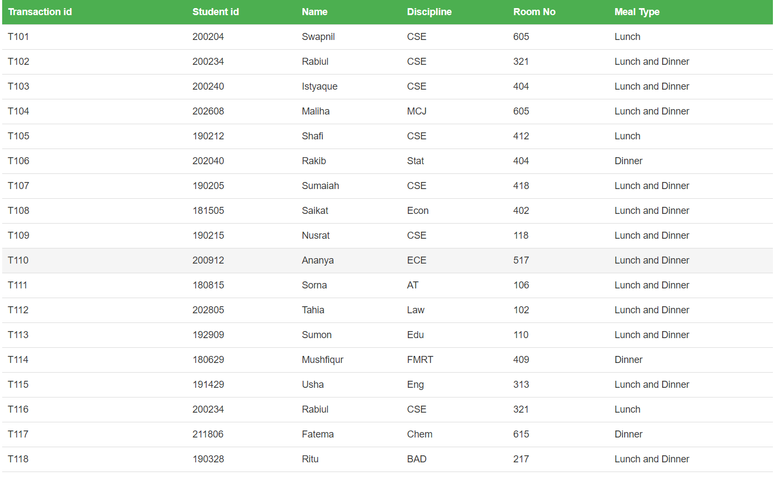
Data

Slide 18
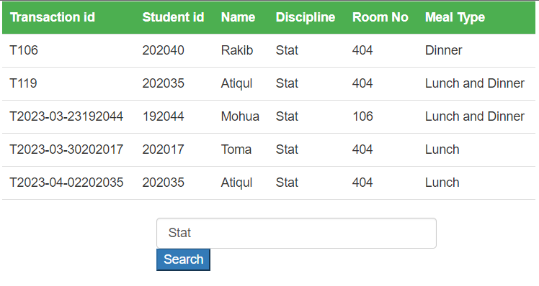
Interesting Query
Student who take meal from Statistics Discipline

Slide 19
Tools and Technologies
Operating system : Windows 11 Home
Framework : .NET
Front end design : HTML, CSS
Back end design : PHP
Workbench : MySQL
Programming language : JAVA
Connectors : jdbc

Slide 20
Thanks!
Istyaque Ahammed(200240)
Sumaiah Binta Musa(190205)
Samundra Dhakal(200245)

